Slide 1
MODULE 3 Wireless Systems and Standards

Slide 2
Contents
Introduction
GSM Architecture
GSM Channels
GSM Protocol Stack
GSM Services
GSM Handover
GSM Security

Slide 3
Introduction

Slide 4
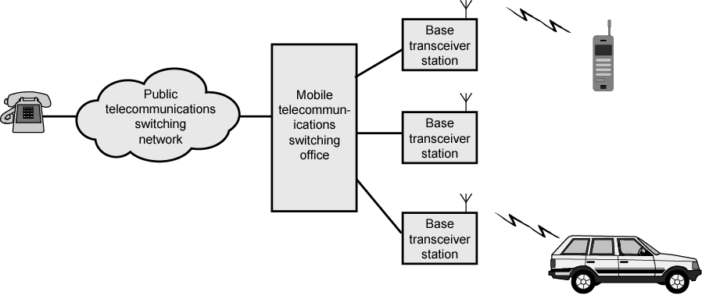
Overview of Cellular System

Slide 5
Operation of Cellular Systems
Base station (BS) at center of each cell
Antenna, controller, transceivers
Controller handles call process
Number of mobile units may in use at a time
BS connected to mobile telecommunications switching office (MTSO)
One MTSO serves multiple BS
MTSO to BS link by wire or wireless
MTSO:
Connects calls between mobile units and from mobile to fixed telecommunications network
Assigns voice channel
Performs handoffs
Monitors calls (billing)
Fully automated

Slide 6
Channels
Control channels
Setting up and maintaining calls
Establish the relationship between the mobile unit and the nearest BS
Traffic channels
Carry voice and data (generally given as two simplex channels)

Slide 7
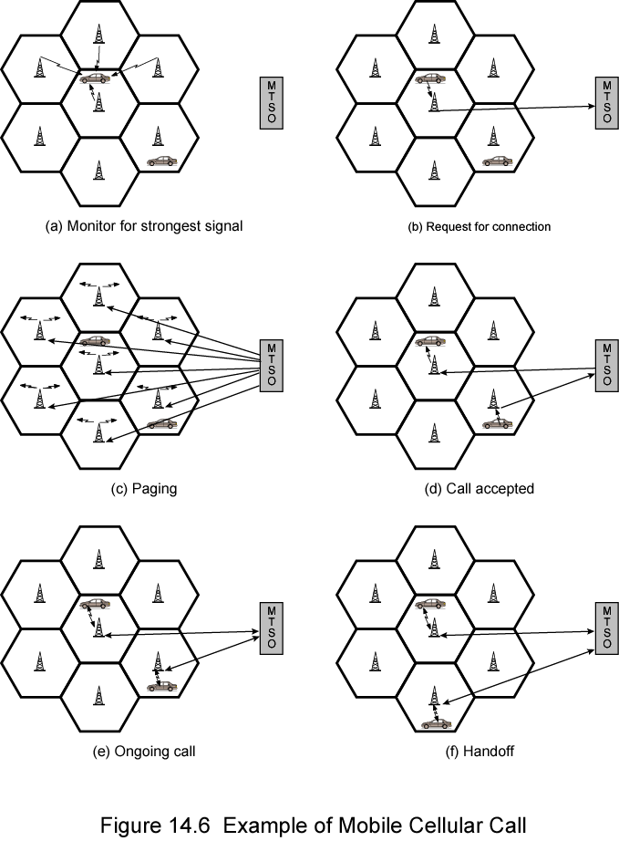
Call Stages

Slide 8
Typical Call in Single MTSO Area (1)
Mobile unit initialization
Scan and select strongest set up control channel
Automatically selected BS antenna of cell
Usually but not always nearest (propagation anomalies)
Handshake to identify user and register location
Scan repeated to allow for movement
Change of cell
Mobile unit monitors for pages (see below)
Mobile originated call
Check set up channel is free
Monitor forward channel (from BS) and wait for idle
Send number on pre-selected channel
Paging
MTSO attempts to connect to mobile unit
Paging message sent to BSs depending on called mobile number
Paging signal transmitted on set up channel

Slide 9
Typical Call in Single MTSO Area (2)
Call accepted
Mobile unit recognizes number on set up channel
Responds to BS which sends response to MTSO
MTSO sets up circuit between calling and called BSs
MTSO selects available traffic channel within cells and notifies BSs
BSs notify mobile unit of channel
Ongoing call
Voice/data exchanged through respective BSs and MTSO
Handoff
Mobile unit moves out of range of cell into range of another cell
Traffic channel changes to one assigned to new BS
Without interruption of service to user

Slide 10
Other Functions
Call blocking
During mobile-initiated call stage, if all traffic channels busy, mobile tries again
After number of fails, busy tone returned
Call termination
User hangs up
MTSO informed
Traffic channels at two BSs released
Call drop
BS cannot maintain required signal strength
Traffic channel dropped and MTSO informed
Calls to/from fixed and remote mobile subscriber
MTSO connects to PSTN
MTSO can connect mobile user and fixed subscriber via PSTN
MTSO can connect to remote MTSO via PSTN or via dedicated lines
Can connect mobile user in its area and remote mobile user

Slide 11
Evolutionary Path
1G - Analog
2G -Digital
History
1983 - 900 Systems (European)
1987 - 1800 Systems with GSM as standard
1991 - First System Deployed ( July)
1992 - First GSM terminals receive interim type approval
1993 - First GSM 1800 network launched
1995 - GSM 1900 network in US & Canada
Specified by ETSI
European Telecommunications Standards Institute
The primary goal is to provide voice services
GSM is the most widely used cellular standard
compatible with already established PSTN & ISDN
Today’s networks are 4G, 5G, (6G)

Slide 12
Introduction- GSM
Integration of
Tele Services
Data Services
Categories of Service
Telephone services – digital voice, SMS,
Bearer Services -data
Supplementary ISDN services- call forwarding, CUG, group calls

Slide 13
GSM – Specifications (Specs)
Maximum cell radius (R): 35 km
Frequency: region around 900 MHz
Maximum vehicle speed (Vm):250 km/hr
Maximum coding delay: approx. 20 ms
Maximum delay spread (Δ_{m}): 10 μs
Bandwidth: Not to exceed 200 kHz

Slide 14
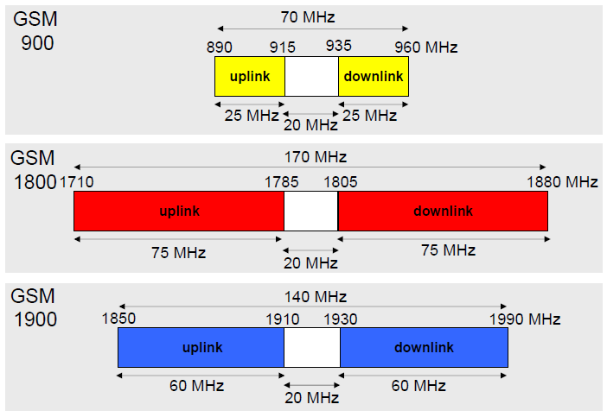
GSM – Frequency Spectra
GSM Radio frequency spectra:
GSM 900 – Standard - Europe
GSM 1800 - DCS ( Digital Cellular System)
GSM 1900 - PCS ( Personal Communcation System)- US

Slide 15
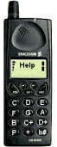
GSM uses paired radio channels
UPLINK
DOWNLINK
890MHz
915MHz
935MHz
960MHz
0
124
0
124

Slide 16
GSM - Radio channels
Time division multiple access-TDMA
124 radio carriers, inter carrier spacing 200khz.
890 to 915 MHz mobile to base - UPLINK
935 to 960 MHz base to mobile - DOWNLINK
8 channels/carrier
GSM combines FDM and TDM: bandwidth is subdivided into channels of 200kHz, shared by up to eight stations, assigning slots for transmission on demand.
Notes:
270.833 kb/s per carrier
GMSK with a time bandwidth product BT =0.3
Slow frequency hoping 217/hops/second.
Synchronization compensation for up to 233micro seconds absolute delay
Block and convolutional channel coding copuled with interleaving to combat channel perturbations- overall channel rate of 22.8 kb/s
Full rate channel 13 kb/s voice coder rate using regular pulse excitation/linear predictive coding RPE/LPC, half rate channel 6.5 kb/s using
Vector coder rate using vector sum excited linear predictivie coding VSELP
Overall full rate channel bit rate of 22.8 kb/s.
Each cell can have from 1 to 16 pairs of carriers.

Slide 17
Global System for Mobile Communication (GSM) Architecture

Slide 18
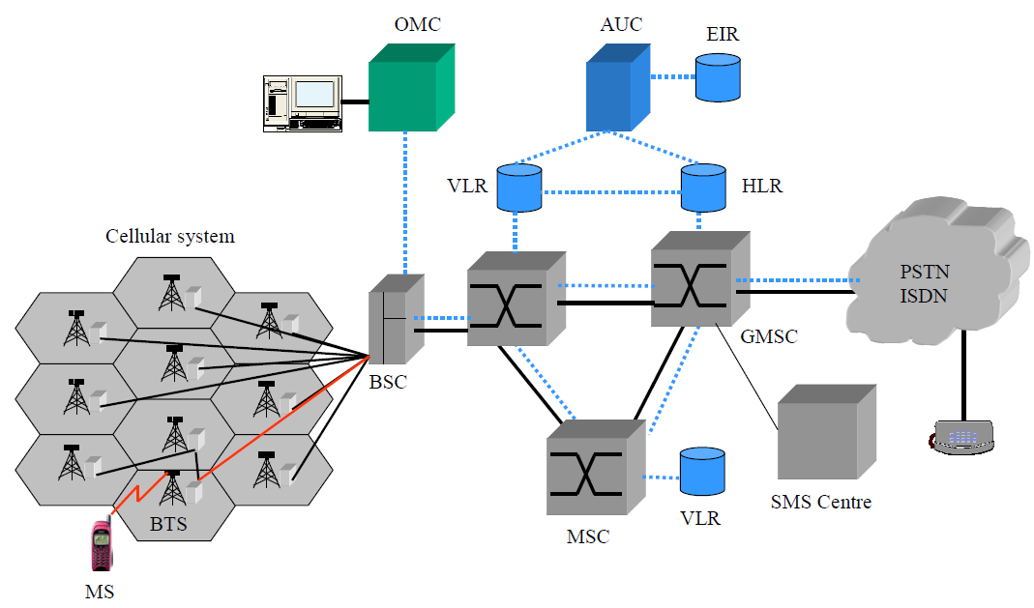
Network Architecture
Base station controller

Slide 19

GSM: Architecture
radio cell
MS
MS
BSS
U_{m}
radio cell
RSS
BTS
MS
Radio subsystem
BTS
Abis interface-BTS and BSC
A_{bis}
BSC
BSC
A
A interface-BSC and MSC
MSC
MSC
NSS
Network and
switching subsystem
VLR
VLR
signaling
HLR
GMSC
ISDN, PSTN
IWF
PDN
Operation Subsystem
OSS
O
EIR
AUC
OMC

Slide 20
Radio Sub System (RSS)

Slide 21
Mobile Station
Subscriber identity module –SIM
International mobile equipment identity –IMEI
PIN

Slide 22
Base Transceiver Station (BTS)
Handles the radio interface to the mobile station.
Consists of one or more radio terminals for transmission and reception
Each Radio terminal represents an RF Channel
TRX and MS communicates over Radio interface
Received data transcoding
Voice encryption/decryption
Signal processing functions of the radio interface
Uplink Radio channel power measurements

Slide 23
Base Station Controller (BSC)
Provides all the control functions and physical links between the MSC and BTS (Base station)
External Interfaces
‘Abis’ interface towards the BTS
‘A’ interface towards the MSC
Monitors and controls several BTSs
Management of channels on the radio interface
Alarm Handling from the external interfaces
Performs inter-cell Handover
Switching from ‘Abis’ link to the ‘A’ link
Interface to OMC for BSS (Base station system) Management

Slide 24
Network and Switching System- NSS

Slide 25
Mobile Switching Center (MSC)
Performs call switching
Interface of the cellular network to PSTN
Queries HLR (home location register)when calls come from PSTN to mobile user
Inter-BSC (Base station controller) Handover
Paging
Billing

Slide 26
Inter BSC handover

Slide 27
Home Location Register (HLR)
Stores user data of all Subscribers related to the GMSC
International Mobile Subscriber Identity(IMSI)
Users telephone number (MS ISDN)
Subscription information and services
Reference to Authentication center for key
Referred when call comes from public land network

Slide 28
Visitor Location Register (VLR)
Database that contains Subscriber parameters and location information for all mobile subscribers currently located in the geographical area controlled by that VLR
Identity of Mobile Subscriber
Copy of subscriber data from HLR
Generates and allocates a Temporary Mobile Subscriber Identity(TMSI)
Location Area Code
Provides necessary data when mobile originates call

Slide 29
Operations Subsystem

Slide 30
Authentication Center (AuC)
Stores Subscriber authentication data called Ki, a copy of which is also stored in in the SIM card
Generates security related parameters to authorize a subscriber (SRES-Signed RESponse)
Generates unique data pattern called Cipher key (Kc) for user data encryption
Provides triplets - RAND, SRES & Kc, to the HLR on request.

Slide 31
EIR (Equipment Identity Register)
EIR is a database that contains a list of all valid mobile station equipment within the network, where each mobile station is identified by its International Mobile Equipment Identity(IMEI).
EIR has three databases.,
White list - For all known,good IMEI’s
Black list - For all bad or stolen handsets
Grey list - For handsets/IMEI’s that are on observation

Slide 32
Global System for Mobile Communication (GSM) Channels

Slide 33
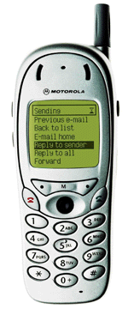
Traffic & Control Signaling
Traffic
«bla bla bla...»
Signaling
« RING ! »
riiiiing
Network
Notes:
The network can carry two types of information:
Traffic: this concerns all the «user to user» information. It can be voice as well as data.
Signaling: the network also needs to carry information for its own working. The purposes of this information are numerous: traffic data routing, maintenance, security. These data are not usually visible from the user’s point of view.
There are several signaling types:
PTS (Per-Trunk Signaling): signaling and voice components are transmitted on the same facility. PTS requires the voice component to be completely built, even if the call can’t be completed.
CCS (Common Channel Signaling): two separate paths are used for information transfer (one for traffic, another for all related signaling information). Thus, CCS allows the voice component to be built separately, which allows resources to be saved. For instance, no voice facilities would be assigned to the call if the dialed number is busy.
GSM works with CCS (no. 7)

Slide 34
Radio Link Aspects
From Speech to RF Signal
Blah... Blah... Blah...
Blah… Blah… Blah...
Digitizing and
Source Coding
Source Decoding
Channel Coding
Channel Decoding
Interleaving
De-interleaving
Ciphering
Deciphering
Burst Formatting
Burst De-formatting
Modulating
Demodulating
Notes:
On the emitting end, speech frames are first coded from analog to digital (source coding) then protected (channel coding). Bits are then interleaved and grouped together in sub-blocks. These sub-blocks are distributed over several bursts modulating a carrier and then transmitted.
On the receiving end, the reverse operations are performed with an option on processing diversity.

Slide 35
Channels : differentiating between Physical and Logical channels
Physical channels : The combination of an ARFCN (absolute radio frequency channel number) and a time slot defines a physical channel.
Logical channels : These are channels specified by GSM which are mapped on physical channels.

Slide 36
Channel concept
Physical channel:
One timeslot of a TDMA-frame on one carrier is referred to as a physical channel.
There are 8 physical channels per carrier in GSM, channel 0-7(timeslot 0-7)
Logical channel:
A great variety of information must be transmitted between BTS and the MS, for e.g. user data and control signaling. Depending on the kind of information transmitted we refer to different logical channels.
These logical channels are mapped on physical channel.

Slide 37
GSM - TDMA/FDD
935-960 MHz
124 channels (200 kHz)
downlink
frequency
890-915 MHz
124 channels (200 kHz)
uplink
higher GSM frame structures
time
GSM TDMA frame
1
2
3
4
5
6
7
8
4.615 ms
GSM time-slot (normal burst)
guard
space
guard
space
tail
user data
S
Training
S
user data
tail
3 bits
57 bits
1
26 bits
1
57 bits
3
546.5 µs

Slide 38

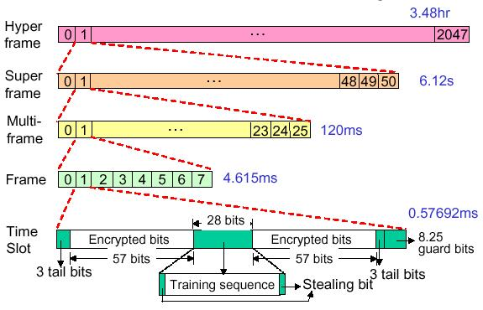
38
38

Slide 39

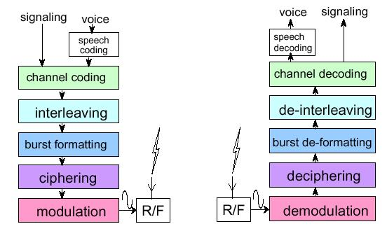
Speech in GSM is digitally coded at a rate of 13 kbps
184 bits ( 20 ms)
260 bits every 20 ms
Convolutional Encoder
456 bits every 20 ms
8 57 bits block
GMSK
Jan 22, 2015
39
39

Slide 40
GSM Channels
GSM Channels
Traffic Channels
(TCHs)
Control Channels
Broadcast
Channels
(BCHs)
Common Control
Channels
(CCCHs)
Dedicated Control
Channels
(DCCHs)
Full
rate
Half
rate
(down uplink)
Downlink
Downlink
Uplink
Fast
Slow
FCCH
PCH
RACH
TCH /F
TCH /H
SCH
BCCH
AGCH
CBCH
SDCCH
FACCH
SACCH
Notes:
Control channels are intended to carry signaling or synchronization data. Three are defined: Broadcast Channels (BCHs), Common Control Channels (CCCHs), Dedicated Control Channels (DCCHs).
Broadcast channels are point-to-multipoint unidirectional (downlink) control channels from the fixed subsystem to the mobile station.
First, BCHs include a Frequency Correction Channel (FCCH) that allows an MS to accurately tune to a Base Transceiver Station (BTS).
Then BCHs contain the Synchronization Channel (SCH), which provide TDMA frame-oriented synchronization data to an MS.
Last, BCHs include the Broadcast Control Channel (BCCH) intended to broadcast a variety of information to MSs, including cues necessary for the MS to register in the network.

Slide 41
Traffic Channels-TCH
TCH carries the voice data.
Two blocks of 57 bits contain voice data in the normal burst.
One TCH is allocated for every active call.
Full rate traffic channel occupies one physical channel(one TS on a carrier) and carries voice data at 13kbps
With channel coding added carries at 22.8kbps
Two half rate (6.5kbps) TCHs can share one physical channel.
User data mappped on to same time slot sent over alternate frames
With channel coding added carries at 11.4kbps

Slide 42
Broadcast channels BCH
Broadcast Channel-BCH
Allotted one ARFCN (absolute radio freq. channel nos.) & is ON all the time in every cell. Transmits in only TS0 and other 7 TS used by TCH.
Frequency correction channel-FCCH
Allow the Ms local oscillator to synchronize to the BS frequency.
Carries a 142 bit zero sequence and repeats once in every 10 frames on the BCH.
Repeats once in every 10 frames.
Synchronization Channel-SCH (timing)
This is used by the MS to synchronize to the TDMA frame structure within the particular cell.
Listening to the SCH the MS receives the TDMA frame number and also the BSIC (base station identity code)( in the coded part- 39 bits).
Repeats once in every 10 frames.

Slide 43
Broadcast channels BCH ...
BCCH (Broadcast control channels)
The information the MS must receive in order to receive calls or make calls -information concerning the cell (cell and network identity, channel availability and congestion).
This include the information of Max power allowed in the cell.
List of channels in use in the cell.
BCCH carriers for the neighboring cells, Location Area Identity etc.
BCCH occupies 4 frames (normal bursts) on BCH and repeats once every Multiframe.
This is transmitted Downlink point to multipoint.

Slide 44
Common Control Channels CCCH
Random access channel-RACH:
Used by Mobile Station for requesting for a channel. When the mobile realizes it is paged it answers by requesting a signaling channel (SDCCH) on RACH.
RACH is also used by the MS if it wants to originate a call.
Uses slotted aloha access scheme

Slide 45
Common Control Channels CCCH ..
Access Grant Channel-AGCH
On request for a signaling channel by MS the network assigns a signaling channel(SDCCH) through AGCH. AGCH is transmitted on the downlink point to point.
Paging Channel-PCH
The information on this channel is a paging message including the MS’s identity(IMSI/TMSI).This is transmitted on Downlink, point-to-multipoint.
Indicates incoming calls originating from PSTN

Slide 46
Dedicated Control Channels-DCCH
Stand alone dedicated control channel(SDCCH)
Provides signalling services required by users
Ensures that MS and BS remain connected while the BS and MSC verify the MS and allocate resources.
Send authentication and alert messages
Acts as a temporary channel that holds traffic which TCH is allocated

Slide 47
Dedicated Control Channels-DCCH
Slow associated control channel-SACCH
Transmission of radio link signal measurement, power control etc.
Average signal strengths(RXLevel) and quality of service (RXQual) of the serving base station and of the neighboring cells is sent on SACCH (on uplink).
Mobile receives information like what TX power it has to transmit and the timing advance. It is associated with TCH or SDCCH
Fast associated control channel-FACCH
Urgent messages
Used for Hand over commands and during call setup and release. FACCH data is sent over TCH with stealing flag set

Slide 48
CDMA Cellular Reuse
Same Frequency is used in every cell
Interference becomes low power noise
Spectral efficiency much higher than AMPS (Advanced Mobile Phone System).
20 times theoretically.
5~8 times in practice.
CDMA Design Parameters ( Same as AMPS )
Forward Channel Frequency → 869 – 894 Mhz
Reverse Channel Frequency → 824 – 849 Mhz
Tx/Rx Frequency Spacing → 45 Mhz

Slide 49
IS-95 CDMA
Existing 12.5 Mhz assigned cellular bands are used to derive 10 different CDMA bands → 1.25 Mhz per band.
Frequency Reuse factor in CDMA = 1.
Channel Rate = 1.2288 Mcps (cycles per sec).
Multipath Fading exploited in CDMA.
Rake receivers are used to combine the output of several received signals.
Fading does occur on the individual signals, but each signal is affected differently and so using several of them to make a decision improves the probability of obtaining a correct decision – Multipath Diversity combining.
At Mobile
Three correlators used to receive three different signals. With a fourth one used as a roving finger which is used to detect new strong incoming signals. Process ensures that the Rake receiver always used the three strongest signals.
At Base Station
All four correlators are used to receive signals → Antenna Diversity.

Slide 50
The Rake receiver
One of the main advantages of the CDMA system is its ability to resolve different multipath components.
This is possible since CDMA is a wide band system.
In order to resolve multipath signals the subscriber unit/BTS should make use of multiple receivers
operating at different phases. Each of these receivers are called fingers.
The outputs of these fingers are added to form a strong output.
Correlator 1
Correlator 1
Output
Correlator 2
Correlator 2
Combiner
Combiner
Input
Input
Correlator 3
Correlator 3
Searcher
Searcher

Slide 51
The Coding and Modulation process in CDMA
64 bit Walsh Codes are used to provide 64 channels within each frequency band.
Walsh codes used for spreading in the forward link.
Walsh codes used to provide orthogonal modulation and not spreading to the full 1.2288 rate in the reverse link.
Besides Walsh codes, 2 other codes are used in IS-95
Long PN code: generated from a 42 bit shift register having (2⁴² – 1) = 4.398 x 10¹² different codes. A mask is used to overlay the codes, the mask differs from channel to channel. The chip rate is 1.2288Mcps. These codes are used for:
Data scrambling/encryption in the forward path
Data spreading and encryption in the reverse path
Short PN code: generated from a pair of 15 bit shift registers having 2¹⁵ –1 = 32767 codes. These codes are used for synchronization in the forward and reverse links and cell identification in the forward link
Each cell uses one of 512 possible offsets.
Adjacent cells must use different offsets.
Chip Rate is 1.2288Mcps ( i.e., not used for spreading )

Slide 52
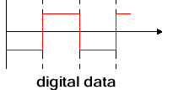
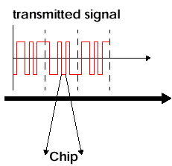
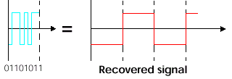
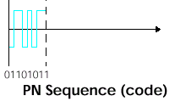
Direct Sequence CDMA
Multiply data with a Pseudo-random noise sequence (PN)

Slide 53
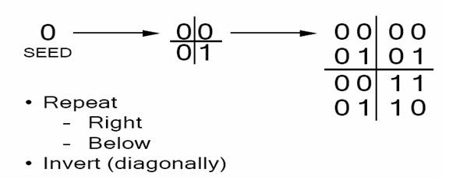
Walsh code

Slide 54
CDMA Channels
Forward and Reverse Channels are separated by 45 Mhz.
Forward Channel comprises of the following channels:
Pilot channel (always uses Walsh code W₀ )
Paging channel(s) ( use Walsh code W₁ – W₇ )
Sync channel (always uses Walsh code W₃₂ )
Traffic channels ( use Walsh codes W₈ – W₃₁ and W₃₃ – W₆₃ )
Reverse Channel comprises of the following channels:
Access channel
Traffic channel
Link Protocol can be summarized as follows:
Mobile acquires phase, timing and signal strength via the Pilot channel
Mobile synchronizes to Base Station via the Sync. Channel
Mobile gets system parameters via the paging channel.
Mobile and BS communicates over the traffic channels during a connection.
Mobile and BS communicate over the access and paging channels during system acquisition and paging.

Slide 56
Forward/Reverse Channel Spreading and Scrambling Process
Forward channels are spread using one of 64 orthogonal Walsh functions. Note – Perfect separation between the channels in the absence of multipath interference.
To reduce interference between mobiles that use the same Walsh function in neighboring cells, all signals in a particular cell are scrambled using the the short PN sequence for cell identification.
For the paging and traffic channels, the long PN sequence is used to scramble the signal before spreading.
Reverse channels are spread using the long PN sequence.
All 64 orthogonal Walsh functions are used to provide orthogonal modulation.
The stream is then scrambled using the short PN sequence for cell identification purposes.

Slide 57
CDMA Vocoder & Transmission Rates
IS-95 supports different transmission rates. The vocoder (QCELP) (Qualcom code excited linear prediction) outputs 9.6 Kbps when there is a full speech signal and 1.2 Kbps when a silent period is detected. (Note 1)
Intermediate rates such as 4.8Kbps and 2.4 Kbps are progressively used to either increase or decrease rates based on the speech signal content.
Rate decisions are made every 20msec interval ( the interval over which samples are collected and processed).
In CDMA – A signal (rate set 1) is always sent for it takes too long for the receivers to ramp up again for reception.
However the bits are output at a correspondingly lower power. For example: the 1.2 Kbps bits are repeated 8 times to bring it up to 9.6 Kbps, but, the signal strength is reduced to 1/8 the power.
Notes:
Note 1 – Studies have shown that 50% of the time there is no speech signal in one direction, and there are pauses in the speech signal

Slide 62
General Packet Radio Service

Slide 63
GPRS
GPRS is an expansion Global System for Mobile Communication. It is basically a packet-oriented mobile data standard on the 2G and 3G cellular communication network’s global system for mobile communication. GPRS was built up by European Telecommunications Standards Institute (ETSI)

Slide 64
Comparison of GSM & GPRS
 | GSM | GPRS
 | Supports only voice | Supports Data over GSM
Data Rates | 9.6 Kbps | 14.4 to 171.2 Kbps
Modulation Technique | GMSK (Gaussian Minimum shift keying) | GMSK
Billing | Duration of connection | Amount of data transferred
Type of Connection | Circuit – Switched Technology | Packet - Switched Technology

Slide 65
GPRS in INDIA
BPL Mobile
Bharti Cellular
Hutchison Max
Hutchison Essar
Idea Cellular

Slide 66
Benefits of GPRS
New Data Services
High Speed (Data Rate 14.4 – 171.2 kbps)
Efficient use of radio bandwidth (Statistical Multiplexing)
Circuit switching & Packet Switching can be used in parallel
Constant connectivity

Slide 67
GPRS: data transfer over GSM
Two enhancements to GSM for data
HSCSD - High Speed Circuit Switched Data
GPRS - General Packet Radio Service
Both have capacity to use new coding schemes and to make multislot allocation
GPRS, being a packet switched service, is known to be more efficient and flexible for data transfer purposes
It delivers circuit and packet-switched services in one mobile radio network

Slide 68
GPRS features
Radio resources are allocated for only one or a few packets at a time, so GPRS enables
many users to share radio resources, and allow efficient transport of packets
fast setup/access times
connectivity to external packet data networks
volume-based charging
GPRS also carries SMS in data channels rather than signaling channels as in GSM

Slide 69
Service Types
Point-to-Point
Internet access by user
Point-to-Multipoint
Delivery of information (e.g. news) to multiple locations or interactive conference applications

Slide 70
QoS Profile for GPRS Bearers
Describes applications characteristics and QoS requirements
4 parameters:
Service precedence
Reliability parameter
Delay parameters
Throughput parameter
Maximum and mean bit rates

Slide 71
GPRS architecture
2G MS (voice only)
NSS
BSS
Abis
E
PSTN
PSTN
A
B
MS
BSC
MSC
C
GMSC
BTS
VLR
D
Gs
SS7
H
Gb
2G+ MS (voice & data)
Gr
HLR
AuC
Gc
Gn
Gi
PSDN
SGSN
IP
GGSN
BSS Base Station System
BTS Base Transceiver Station
BSC Base Station Controller
NSS Network Sub-System
MSC Mobile-service Switching Controller
VLR Visitor Location Register
HLR Home Location Register
AuC Authentication Server
GMSC Gateway MSC
SGSN Serving GPRS Support Node
GGSN Gateway GPRS Support Node
GPRS General Packet Radio Service

Slide 72
GPRS architecture
Requires addition of a new class of nodes called GSNs (GPRS Support Nodes)
SGSN: Serving GPRS Support Node,
GGSN: Gateway GPRS Support Node
Base Station Controller requires a PCU (Packet Control Unit) and various other elements of the GSM n/w require software upgrades
All GSNs are connected via an IP-based backbone. Protocol data units (PDUs) are encapsulated and tunneled between GSNs

Slide 73
SGSN (Serving GPRS Support Node)
Analogue of the MSC in GSM
Routes incoming and outgoing packets addressed to and from any GPRS subscriber located within the geographical area served by the SGSN
Location Register of the SGSN stores information (e.g. current cell and VLR) and user profiles (e.g. IMSI, addresses) of all GPRS users registered with this SGSN

Slide 74
GGSN (Gateway GPRS support node)
Serves as the interface to external IP networks which see the GGSN as an IP router serving all IP addresses of the MSs
GGSN stores current SGSN address and profile of the user in its location register
It tunnels protocol data packets to and from the SGSN currently serving the MS
It also performs authentication and charging
GGSN can also include firewall and packet-filtering mechanisms

Slide 75
BSC and others
BSC must get a Packet Control Unit to
set up, supervise and disconnect packet-switched calls
also support cell change, radio resource configuration and channel assignment
MSC/VLR, HLR and SMS Center must be enhanced for interworking with GPRS
MS must be equipped with the GPRS protocol stack

Slide 76
HLR - Home Location Register
Shared database, with GSM
Is enhanced with GPRS subscriber data and routing information
For all users registered with the network, HLR keeps user profile, current SGSN and Packet Data Protocol (PDP) address(es) information
SGSN exchanges information with HLR e.g., informs HLR of the current location of the MS
When MS registers with a new SGSN, the HLR sends the user profile to the new SGSN

Slide 77
VLR-Visitor Location Register
VLR is responsible for a group of location areas. It stores data of only those users in its area of responsibility
MSC/VLR can be enhanced with functions and register entries that allow efficient coordination between GPRS and GSM services
combined location updates
combined attachment procedures

Slide 78
MS modes
Class A: MS can operate simultaneous packet switched and circuit switched services
Class B: MS can operate either one at one time
Class C: MS can operate only packet switched services

Slide 79
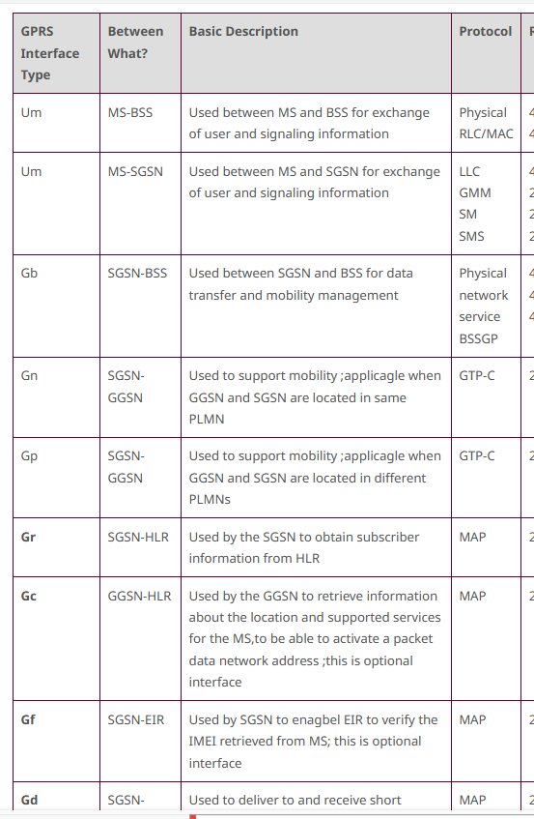
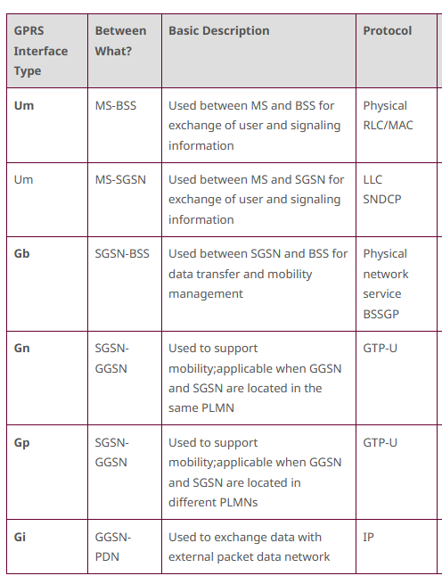
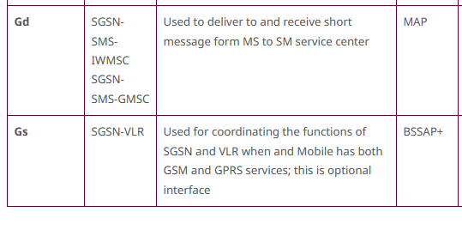
Interfaces in GPRS
Control Plane
Transmission
Plane

Slide 80
GPRS summary
Enables many users to share radio resources by dynamic, on-demand, multi-slot allocation
Provides connectivity to external packet data networks
Modification to the GSM air-interface
Addition of new GPRS Support Nodes
Assignment of PDP (Packet Data Protocol) context to MS
Enables volume-based charging as well as duration based charging

Slide 81
UMTS-Universal Mobile Telecommunication System Core Network
The basic Core Network architecture for UMTS is based on GSM network with GPRS.
However, all equipment has to be modified for UMTS operation and services.
The Core Network is divided in circuit switched and packet switched domains.
Some of the circuit switched elements are (MSC), (VLR) and Gateway MSC.
Packet switched elements are (SGSN) and (GGSN).
Some network elements, like EIR(Equipment Identity Register), HLR, and AUC are shared by both domains.

Slide 82
UMTS- UTRAN
UMTS differs from GSM Phase 2+ mostly in the new principles for air interface transmission
(W–CDMA instead of TDMA/ FDMA).
The UTRAN (UMTS Terrestrial Radio Access Network, based on W–CDMA )provides the air interface access method for User Equipment.
Two new network elements are introduced in UTRAN,
RNC (Radio Network Controller) – Base station Controller
The RNC is connected to a set of Node B elements, each of which can serve one or several cells.
Node B (Base station)

Slide 83
UMTS- UTRAN
The UMTS Terrestrial Radio Access System (UTRA) provides at least:
144 kbps for full-mobility applications,
384 kbps for limited-mobility applications,
2.048 Mbps for low-mobility applications.

Slide 84
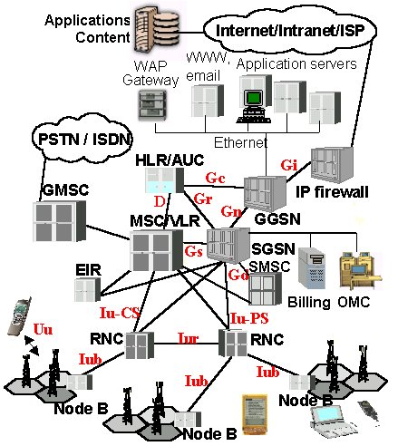
UMTS architecture

Slide 85
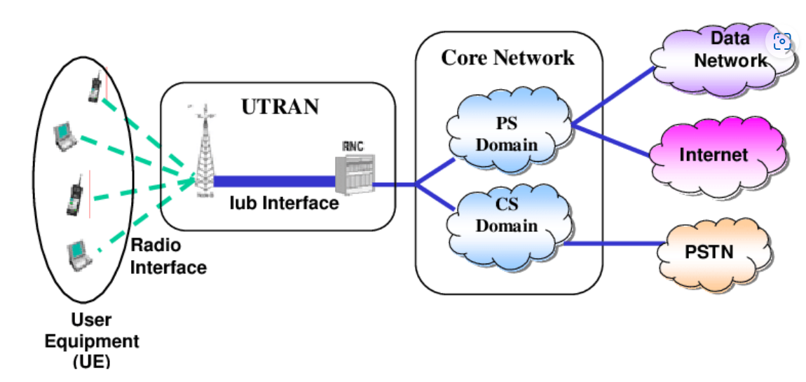
UMTS Architecture

Slide 86
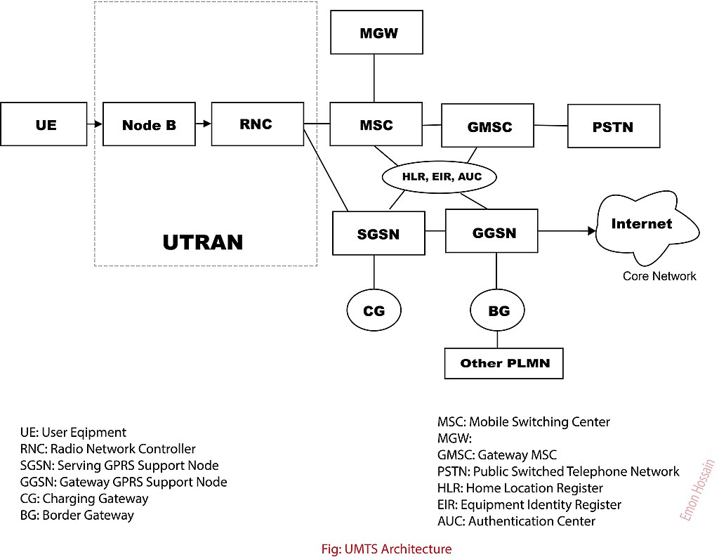
Media Gateway (MGW)

Slide 87
3G rel99 Architecture (UMTS) 3G Radio (Internet/radio access)
2G MS (voice only)
CN
BSS
Abis
E
PSTN
PSTN
A
B
BSC
MSC
C
GMSC
BTS
Gb
VLR
D
Gs
SS7
2G+ MS (voice & data)
H
IuCS
RNS
Gr
HLR
ATM
AuC
Gc
Iub
IuPS
Gn
Gi
PSDN
RNC
SGSN
IP
GGSN
Node B
3G UE (voice & data)
BSS Base Station System
BTS Base Transceiver Station
BSC Base Station Controller
RNS Radio Network System
RNC Radio Network Controller
CN Core Network
MSC Mobile-service Switching Controller
VLR Visitor Location Register
HLR Home Location Register
AuC Authentication Server
GMSC Gateway MSC
SGSN Serving GPRS Support Node
GGSN Gateway GPRS Support Node
UMTS Universal Mobile Telecommunication System

Slide 88
3G rel4 Architecture (UMTS) - Soft Switching
2G MS (voice only)
CN
Nb
CS-MGW
BSS
A
CS-MGW
PSTN
Abis
Nc
PSTN
Mc
Mc
B
BSC
MSC Server
C
GMSC server
BTS
Gb
VLR
D
Gs
SS7
2G+ MS (voice & data)
H
IuCS
RNS
Gr
HLR
IP/ATM
ATM
AuC
Gc
Iub
IuPS
Gn
Gi
PSDN
RNC
SGSN
GGSN
Node B
3G UE (voice & data)
BSS Base Station System
BTS Base Transceiver Station
BSC Base Station Controller
RNS Radio Network System
RNC Radio Network Controller
CN Core Network
MSC Mobile-service Switching Controller
VLR Visitor Location Register
HLR Home Location Register
AuC Authentication Server
GMSC Gateway MSC
SGSN Serving GPRS Support Node
GGSN Gateway GPRS Support Node

Slide 89
Benefits of Media Gateways
Media gateway -translation device or service that converts media streams between different technologies such as SS7, 2G, 2.5G and 3G radio access networks) or PBX systems
Media gateways enable communications across packet networks using transport protocols such as Asynchronous Transfer Mode (ATM) and Internet Protocol (IP)
Media gateway function is to convert between different transmission and coding techniques

Slide 90
3G rel5 Architecture (UMTS) - IP Multimedia
2G MS (voice only)
CN
Nb
CS-MGW
BSS
A/IuCS
CS-MGW
PSTN
Abis
Nc
PSTN
Mc
Mc
B
BSC
MSC Server
C
GMSC server
BTS
Gb/IuPS
VLR
D
Gs
SS7
2G+ MS (voice & data)
ATM
H
IuCS
RNS
Gr
HSS
IP/ATM
AuC
Gc
Iub
IuPS
Gn
Gi
IP Network
RNC
SGSN
GGSN
Node B
3G UE (voice & data)
IM-MGW
IM
IM IP Multimedia sub-system
MRF Media Resource Function
CSCF Call State Control Function
MGCF Media Gateway Control Function (Mc=H248,Mg=SIP)
IM-MGW IP Multimedia-MGW
Gs
PSTN
IP
Mg
Mc
MRF
MGCF
CSCF

Slide 91
The Core Network of UMTS is same as that of GPRS. The air interface is totally different. We therefore only discuss the air interface. The air interfaces in UMTS are listed below:
Uu: UE to Node B (UTRA, the UMTS W-CDMA air interface
Iu: RNC to GSM Phase 2+ CN interface (MSC/VLR or SGSN)
Iu-CS for circuit-switched data
Iu-PS for packet-switched data
Iub: RNC to Node B interface
Iur: RNC to RNC interface, not comparable to any interface in GSM
The Iu, Iub, and Iur interfaces are based on ATM transmission principles.

Slide 92
What is LTE?
LTE stands for “Long Term Evolution”
Fourth-generation (4G) cellular technology from 3GPP
Deployed worldwide
4G LTE: First global standard
Increased speed
IP-based network (All circuits are gone/fried!)
New air interface: OFDMA (Orthogonal Frequency-Division Multiple Access), MIMO (multiple antennas)
Also includes duplexing, timing, carrier spacing, coding...
New service paradigm (e.g., VoLTE)
Notes:
CAT 3, CAT 4, CAT 6 (different radio technology), → different speed
All implementations must meet baseline requirements
Increased speed
IP-based network (All circuits are gone/fried!)
New air interface: OFDMA (Orthogonal Frequency-Division Multiple Access), MIMO (multiple antennas)
Also includes duplexing, timing, carrier spacing, coding...

Slide 93
4G Network Architecture (LTE)
4G Packet-Switched
MME: Mobility Management Entity
BS: Base Station (4G: eNodeB)
Notes:
Let us look at the mobile network architecture to see how these services are made possible.
Here it is a 4G LTE network architecture which only supports packet-switched service.
It consists of two parts:
First, base stations to offer radio access
Second, core network which consists of MME (Mobility Management Entity) and 4G PS gateways .
The MME is used to manage user mobility, e.g., location update.
The 4G PS Gateways route packets between Internet and 4G Base stations

Slide 94
3G/4G Network Architecture
4G Packet-Switched
3G Packet-Switched
3G Circuit-Switched
Notes:
Now we take a look at 3G network architecture.
Similar to 4G LTE, it has Base station and core networks.
The major difference is that 3G supports both Circuit-Switched and Packet-Switched services.
3G CS Gateways are used to connect to 3G base stations and telephony networks.
3G PS Gateways plays role similar to 4G PS Gateway.
The main difference is that 3G PS Gateways are responsible for control-plane and data-plane functions at same.
In 4G LTE, the control-plane functions are moved to MME.

Slide 95
Operations
Two main planes in operation in parallel:
Data plane (also called User plane): content delivery
Control plane: signaling functions
There is an additional plane that works with the above two planes:
Management plane: configurations, monitoring

Slide 96

Illustration of Data and Control Planes
Network
Infrastructure
Application
Transport
IP
IP
Data-plane
Control-
Plane
Data-plane
Control-
Plane

Slide 97
Illustration of Data and Control Planes
97
97
EPS: Evolved Packet System
PDCP: Packet Data Convergence Protocol
RLC: Radio Link Control
MAC: Medium Access Control

Slide 98
Data-Plane Protocols: IP + lower layers
@UE (IP)
@eNB (IP)
Packet Data Convergence Protocol (PDCP) – header compression, radio encryption
Radio Link Control (RLC) – Readies packets to be transferred over the air interface
Medium Access Control (MAC) – Multiplexing, QoS
PDCP
PDCP
RLC
RLC
MAC
MAC
PHY
PHY
Notes:
Wireless technology, main evolution across different generations and releases are in PHY layer

Slide 99
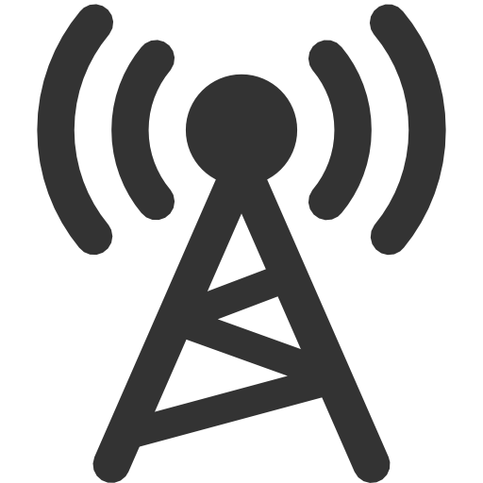

Control-Plane Protocols
Control utilities: mobile network specific
Different from Internet counterparts
Data-plane
Control-plane
Internet
P3: Conn.
context
(QoS)
Connectivity Management
Mobility Management (MM)
P2: Location
update
Radio Resource Control (RRC)
P1: Radio conn. setup
Notes:
It means that the network side implements complex functions.
(2) To support data delivery in the data-plane, it has to support rich control-plane functions like radio resource control, mobility support, connectivity management, QoS control etc.
(3) They are much more complex than the control in the Internet.

Slide 100
Control-Plane Protocols in 4G/3G
Variants for same/similar control functions
Hybrid 4G/3G systems
Domains separated for voice (CS) and data (PS)
Notes:
(1 ) Layered protocol stack
(2) Variants
(3) Complicated (rich set of control protocols)

Slide 101
Distributed Operations: Device, base station, core networks
101

Slide 102
Data and Control Planes in LTE
eNodeB, S-GW and P-GW are involved in session setup, handoff, routing
Control Plane
Home Subscriber Server (HSS)
Data Plane
Mobility Management Entity (MME)
Packet Data
Base Station
Serving
Network Gateway
(P-GW)
User Equipment (UE)
\Station (eNodeB)
Gateway (S-GW)

Slide 103
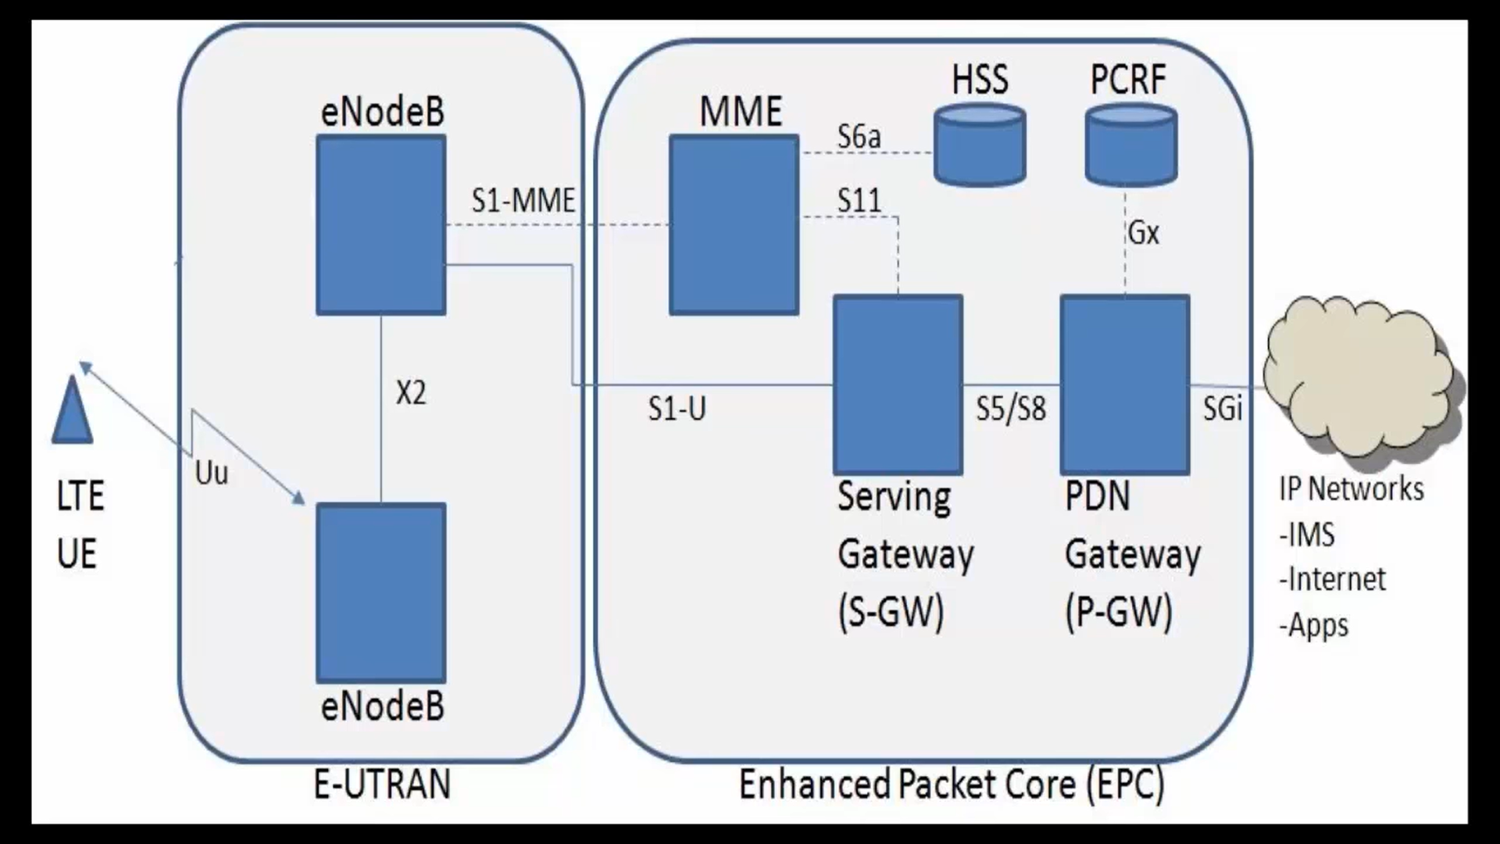
LTE Architecture

Slide 104
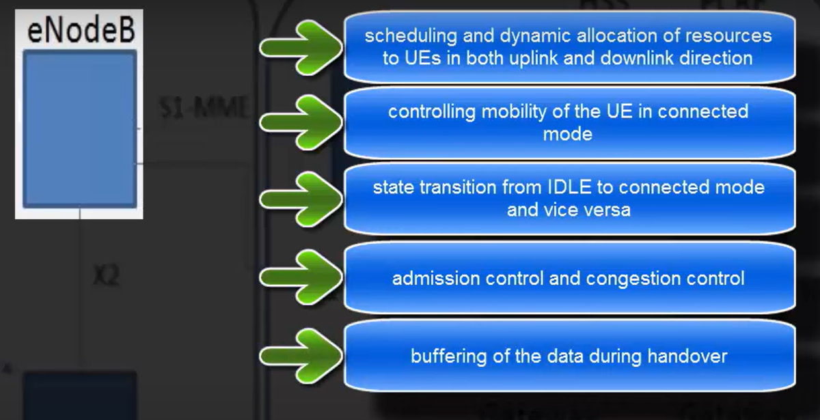

Slide 105
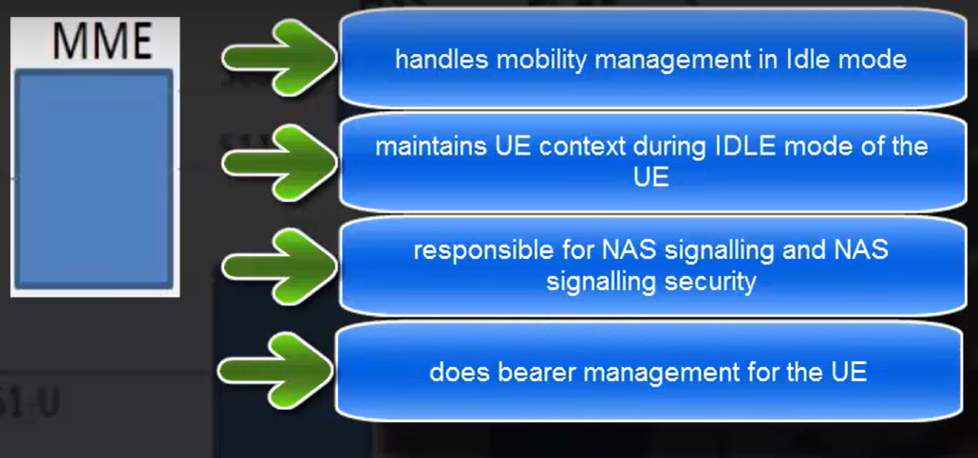

Slide 106
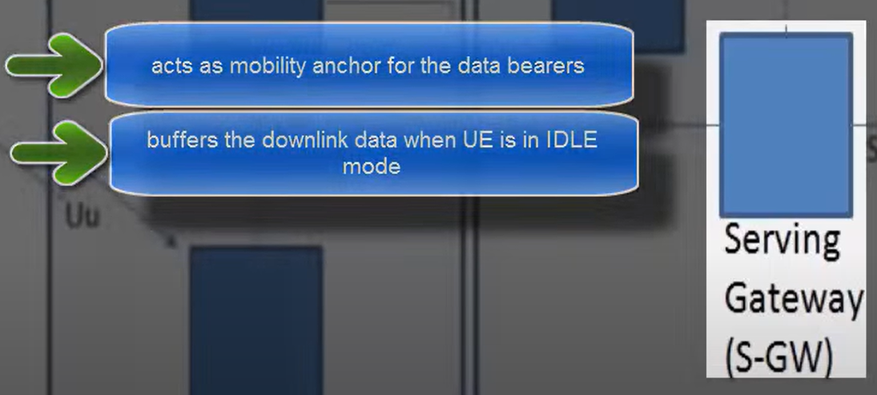

Slide 107
